Slide 1
MACHINE LEARNING PROJECT
Wine Type Classification
System
A regularized logistic regression approach to identify wine as red or white from its chemical properties, with a confidence score and a feature-based explanation for every prediction.
D. Venya sri – 2520030531
K. Vansika Reddy – 2520030527
Section – 9
Team no - 28
Problem Definition
Dataset & EDA
Preprocessing
Modeling

Slide 2
PROBLEM DEFINITION
What We're Solving, and Why It Matters
1
What problem are we solving?
2
Why is this problem important?
Classifying a wine sample as red or white from its lab-measured chemical properties, without tasting or visual inspection.
Wine type drives pricing, labelling and quality control. Automating it makes checks fast and objective, and can flag mislabelled or blended samples.
3
Who will use the solution?
4
What is the expected output?
Wineries and quality-control labs, wine retailers and analysts who need a quick, explainable check on a sample's type.
For each sample, a prediction (red or white), a confidence score, and the top chemical features that explain the decision.

Slide 3
ABSTRACT
Project Overview
Core Techniques
Wine type classification is an important application of machine learning that can help automate the identification of wine based on its chemical properties. This project proposes a Regularized Logistic Regression-based Wine Type Classification System that classifies wine as either Red or White using physicochemical features such as acidity, residual sugar, chlorides, sulphates, alcohol content, density, and pH. Regularization is incorporated into the logistic regression model to reduce overfitting, improve generalization, and select the most meaningful features for classification. The proposed system evaluates the model using accuracy, precision, recall, F1-score, and a confusion matrix. Unlike a basic wine classifier, the system can also provide a confidence score and feature-based explanation for each prediction, allowing users to understand why a particular wine is classified as red or white. This makes the system more transparent, lightweight, and suitable for practical wine-quality analysis and decision-support applications.
Logistic Regression
Supervised classification of red vs. white wine
L1 / L2 Regularization
Reduces overfitting and selects key features
Evaluation Metrics
Accuracy
Precision
Recall
F1-Score
Confusion Matrix
ROC-AUC

Slide 4
DATASET COLLECTION
Sourcing and Understanding the Dataset
Source
Dataset Schema
UCI Machine Learning Repository — “Wine Quality” dataset (Cortez et al., 2009), Portuguese Vinho Verde wines. The red and white CSV files were downloaded and merged into one file for analysis.
Acidity
fixed, volatile, citric acid, pH
Sugar & Salts
Target / Output Column
residual sugar, chlorides, sulphates
type — red or white, encoded as is_white (1 = white, 0 = red). This is the column the model is trained to predict.
SO₂ & Body
free SO₂, total SO₂, density, alcohol
type
Feature Columns
Target: red / white
11 physicochemical measurements from lab tests. The quality column is a subjective tasting score, so it is not used as an input.
6,497
13
Rows
Columns

Slide 5
DATA UNDERSTANDING
Getting to Know the Dataset
6,497
11
Numeric
Records
Features (+ quality, type)
Data Types (11 float, 1 int, 1 text)
0
1,177
2
Missing Values
Duplicate Rows
Unique Classes (red, white)
Statistical Summary & Distributions
df.describe() shows total SO₂ ranging from 6 to 440 mg/dm³ (mean ≈ 116), residual sugar from 0.6 to 65.8 g/dm³ (right-skewed, mean ≈ 5.4), alcohol from 8 to 14.9 % (mean ≈ 10.5) and pH from 2.72 to 4.01. Feature distributions by wine type are explored in the EDA section.

Slide 6
DATA PREPROCESSING
Cleaning and Preparing the Data
1
Missing Values
2
Duplicate Records
Checked with df.isnull().sum() — none found, so no imputation was required.
1,177 duplicate rows removed with drop_duplicates(), leaving 5,320 unique wines and preventing train/test leakage.
3
Outliers
4
Incorrect Data
Reviewed with the IQR rule and box plots (about 3–6% in acidity, chlorides, sulphates); retained as genuine measurements.
Verified no negative values, pH within 2.72–4.01, free SO₂ never above total SO₂, and type only red or white.
5
Categorical Variables
6
Numerical Variables
Only ‘type’ is categorical — label-encoded as the target (white = 1, red = 0).
All 11 features standardized with StandardScaler, fitted on training data only, so regularization treats them fairly.

Slide 7
EXPLORATORY DATA ANALYSIS
Class Balance at a Glance
Class Distribution
1
Moderate Class Imbalance
About 3 in 4 samples are white, so accuracy alone can mislead — recall, F1 and ROC-AUC matter.
2
Strongly Separating Features
Total SO₂ (r = 0.69) and volatile acidity (r = −0.65) correlate most with wine type.
3
Very Different Scales
Features range from 0.01 (chlorides) to 440 (total SO₂), so standardization is needed.
4
No Missing Data
White wine makes up about 74.5% of the 5,320 unique samples.
The data is complete, so preprocessing focuses on duplicates and scaling, not imputation.
5,320
1,359
3,961
74.5%
Unique Wines
Red Wines
White Wines
White Share

Slide 8
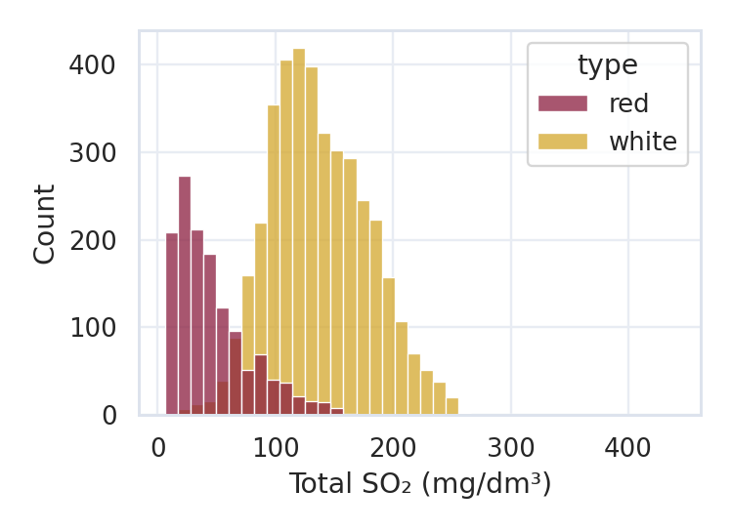
EXPLORATORY DATA ANALYSIS
Visualizing the Wine Data
Histogram — Total SO₂ Distribution
Bar Chart — Avg. Value by Wine Type
Count Plot — Wine Type Counts
White wines carry far more sulfur dioxide (median 133 vs 38 mg/dm³), so the two types barely overlap.
White wines are sweeter (5.9 vs 2.5 g/dm³) and less acidic (6.8 vs 8.3); alcohol is almost identical.
Red wines are about 26% of the 5,320 unique samples, so class-aware metrics are important.

Slide 9
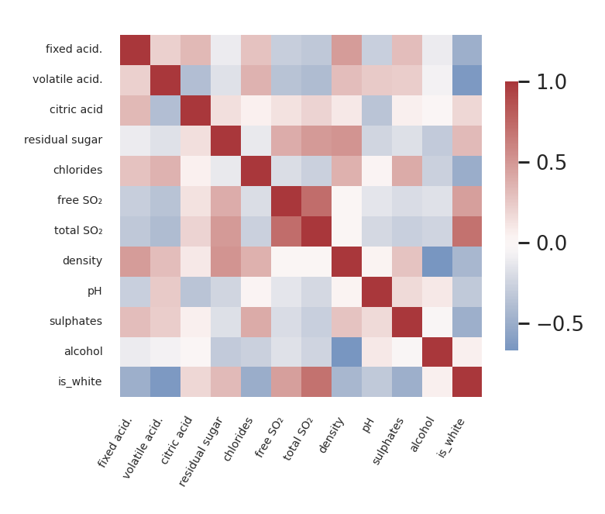
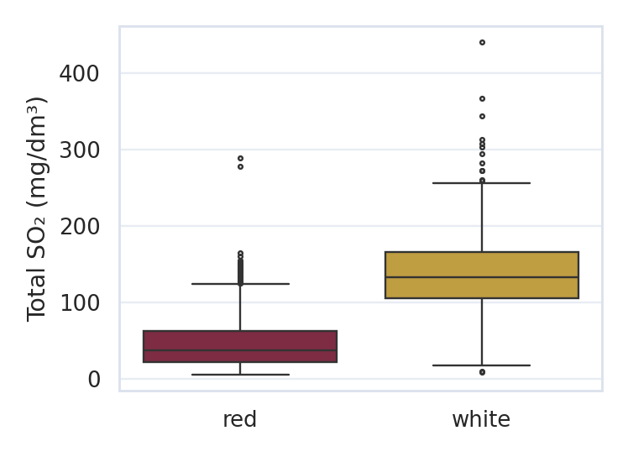
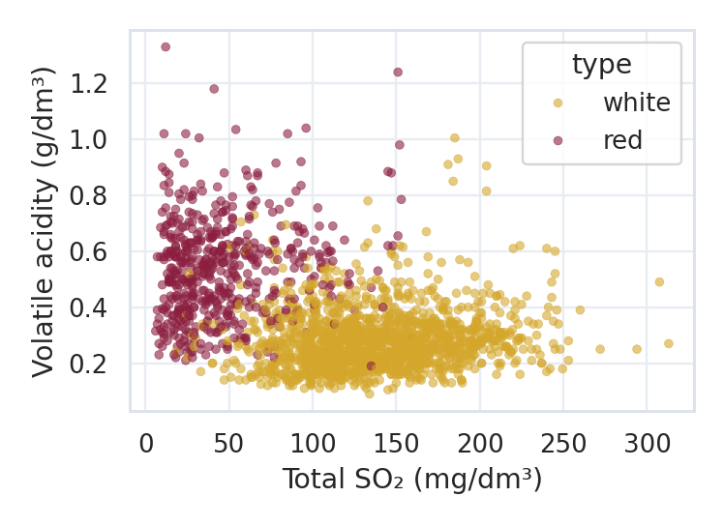
EXPLORATORY DATA ANALYSIS
Spotting Patterns and Relationships
Box Plot — Total SO₂ by Type
Scatter Plot — SO₂ vs Volatile Acidity
Correlation Heatmap
White wines have a much higher median total SO₂ (133 vs 38 mg/dm³) and a wider spread.
Red wines sit at high volatile acidity and low SO₂; whites cluster at low acidity and high SO₂.
Total SO₂ (+0.69) and volatile acidity (−0.65) relate most to wine type; chlorides, sulphates and density also matter.

